Slide 1
Introduction to Cypher
<Your name and details>

Slide 2
In this session
We will cover:
Property graph database anatomy
Introduction to Cypher
Continuing your graph journey

Slide 3
So what does a (property) graph look like?

Slide 4
Graph components
Node (Vertex)
The main data element from which graphs are constructed
Jane
car

Slide 5
Graph components
Node (Vertex)
The main data element from which graphs are constructed
Relationship (Edge)
A link between two nodes. Has:
Direction
Type
A node without relationships is permitted. A relationship without nodes is not
Jane
car
OWNS

Slide 6
Property graph database
Node (Vertex)
Relationship (Edge)
OWNS

Slide 7
Property graph database
Node (Vertex)
Relationship (Edge)
Label
Define node category (optional)
:Person
:Car
OWNS

Slide 8
Property graph database
Node (Vertex)
Relationship (Edge)
Label
Define node category (optional)
Can have more than one
:Person
:Car
:Asset
OWNS

Slide 9
Property graph database
Node (Vertex)
Relationship (Edge)
Label
Define node category (optional)
Can have more than one
:Person
:Car
:Asset
OWNS
since: 2018
Properties
Enrich a node or relationship
No need for nulls!
name: Jane
make: Volvo
model: V60

Slide 10
How do I query the graph?

Slide 11
Cypher
A pattern-matching query language made for graphs
‹#›￼

Slide 12
Cypher
A pattern matching query language made for graphs
Declarative
Expressive
Pattern-Matching
‹#›￼

Slide 13
Cypher
A pattern matching query language made for graphs
Declarative
Expressive
Pattern Matching
With ASCII ART ¯\_(ツ)_/¯
‹#›￼

Slide 14
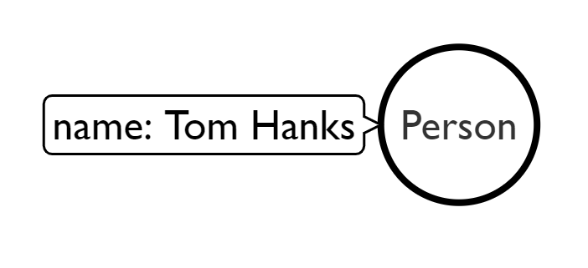
Use MATCH to retrieve nodes
//Match all nodes
MATCH (n)
RETURN n;

Slide 15
Use MATCH to retrieve nodes
//Match all nodes
MATCH (n)
RETURN n;
//Match all nodes with a Person label
MATCH (n:Person)
RETURN n;

Slide 16
Use MATCH to retrieve nodes
//Match all nodes
MATCH (n)
RETURN n;
//Match all nodes with a Person label
MATCH (n:Person)
RETURN n;
//Match all nodes with a Person label and property name is "Tom Hanks"
MATCH (n:Person {name: "Tom Hanks"})
RETURN n;

Slide 17
Use MATCH and properties to retrieve nodes
//Return nodes with label Person and name property is "Tom Hanks" - Inline
MATCH (p:Person {name: "Tom Hanks"}) //Only works with exact matches
RETURN p;

Slide 18
Use MATCH and properties to retrieve nodes
//Return nodes with label Person and name property is "Tom Hanks" - Inline
MATCH (p:Person {name: "Tom Hanks"}) //Only works with exact matches
RETURN p;
//Return nodes with label Person and name property equals "Tom Hanks"
MATCH (p:Person)
WHERE p.name = "Tom Hanks"
RETURN p;

Slide 19
Use MATCH and properties to retrieve nodes
//Return nodes with label Person and name property is "Tom Hanks" - Inline
MATCH (p:Person {name: "Tom Hanks"}) //Only works with exact matches
RETURN p;
//Return nodes with label Person and name property equals "Tom Hanks"
MATCH (p:Person)
WHERE p.name = "Tom Hanks"
RETURN p;
//Return nodes with label Movie, released property is between 1991 and 1999
MATCH (m:Movie)
WHERE m.released > 1990 AND m.released < 2000
RETURN m;

Slide 20
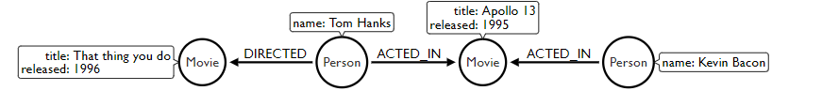
Extending the MATCH

Slide 21
Extending the MATCH
//Find all the movies Tom Hanks acted in
MATCH (:Person {name:"Tom Hanks"})-[:ACTED_IN]->(m:Movie)
RETURN m.title;

Slide 22
Extending the MATCH
//Find all the movies Tom Hanks acted in
MATCH (:Person {name:"Tom Hanks"})-[:ACTED_IN]->(m:Movie)
RETURN m.title;
//Find all the movies Tom Hanks directed and order by latest movie
MATCH (:Person {name:"Tom Hanks"})-[:DIRECTED]->(m:Movie)
RETURN m.title, m.released ORDER BY m.released DESC;

Slide 23
Extending the MATCH
//Find all the movies Tom Hanks acted in
MATCH (:Person {name:"Tom Hanks"})-[:ACTED_IN]->(m:Movie)
RETURN m.title;
//Find all the movies Tom Hanks directed and order by latest movie
MATCH (:Person {name:"Tom Hanks"})-[:DIRECTED]->(m:Movie)
RETURN m.title, m.released ORDER BY m.released DESC;
//Find all of the co-actors Tom Hanks have worked with
MATCH (:Person {name:"Tom Hanks"})-->(:Movie)<-[:ACTED_IN]-(coActor:Person)
RETURN coActor.name;

Slide 24
CREATE
//Create a person node called "Tom Hanks"
CREATE (p:Person {name:"Tom Hanks"});

Slide 25
CREATE
//Create a person node called "Tom Hanks"
CREATE (p:Person {name:"Tom Hanks"});
//Create an ACTED_IN relationship between "Tom Hanks" and "Apollo 13"
MATCH (p:Person {name:"Tom Hanks"}), (m:Movie {title:"Apollo 13"})
CREATE (p)-[:ACTED_IN]->(m);

Slide 26
CREATE
//Create a person node called "Tom Hanks"
CREATE (p:Person {name:"Tom Hanks"});
//Create an ACTED_IN relationship between "Tom Hanks" and "Apollo 13"
MATCH (p:Person {name:"Tom Hanks"}), (m:Movie {title:"Apollo 13"})
CREATE (p)-[:ACTED_IN]->(m);
//Create the pattern of "Tom Hanks" ACTED_IN "Apollo 13"
//This will create the entire pattern, nodes and all!
CREATE (:Person {name:"Tom Hanks")-[:ACTED_IN]->(:Movie {title:"Apollo 13});

Slide 27
Time to have a go!
We are going to:
Go to sandbox.neo4j.com
Sign in
Select "Blank sandbox" and click Launch Project
We’ll all have a go together :)

Slide 28
So how do I continue my graph journey?

Slide 29
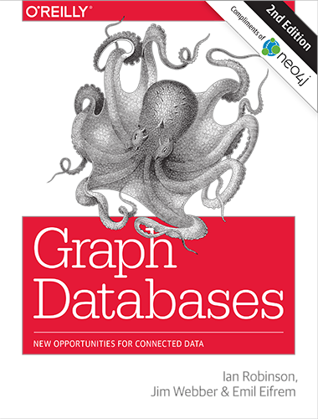
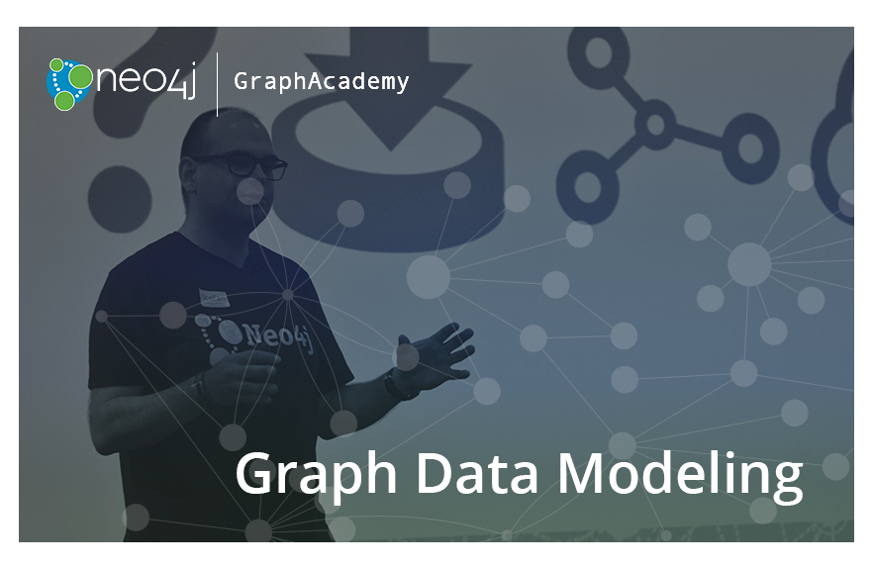
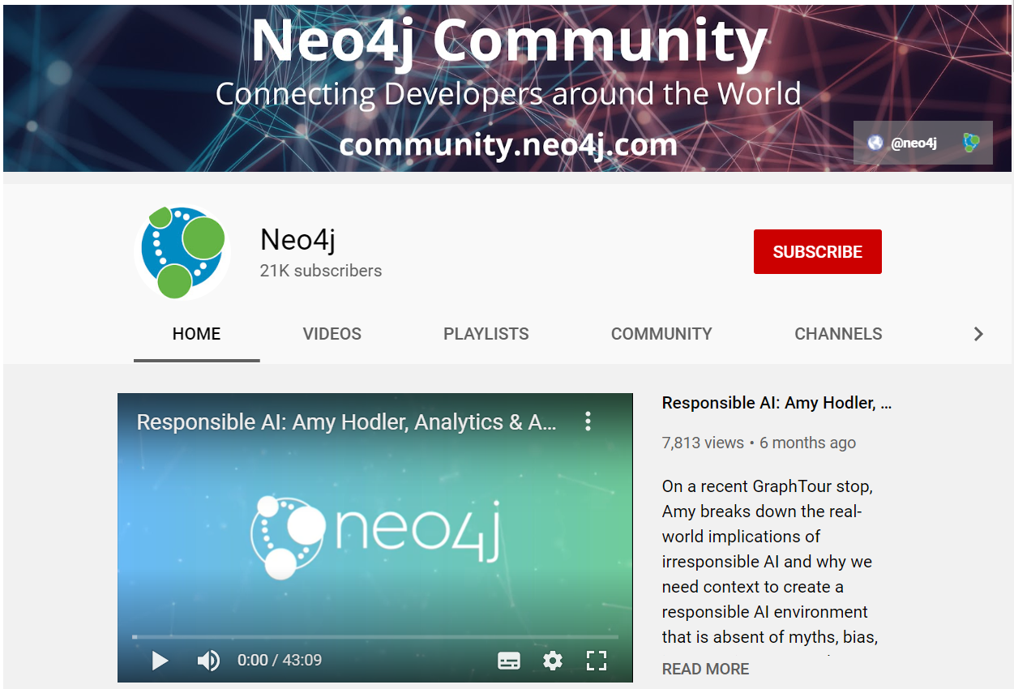
Free book:
neo4j.com/graph-databases-book
Free online training and certification:
neo4j.com/graphacademy/online-training
How to, best practices and customer stories:
youtube.com/neo4j

